Slide 1
dbms
Module 5 part 1

Slide 2
index
Transaction
ACID Properties
Concurrency control
Transaction Model
Transaction States
System Log

Slide 3
transaction
Transactions group a set of tasks into a single execution unit.
Each transaction begins with a specific task and ends when all the tasks in the group successfully complete.
If any of the tasks fail, the transaction fails. Therefore, a transaction has only two results: success or failure.
Incomplete steps result in the failure of the transaction.
A database transaction, by definition, must be atomic, consistent, isolated and durable. These are popularly known as ACID properties.

Slide 4
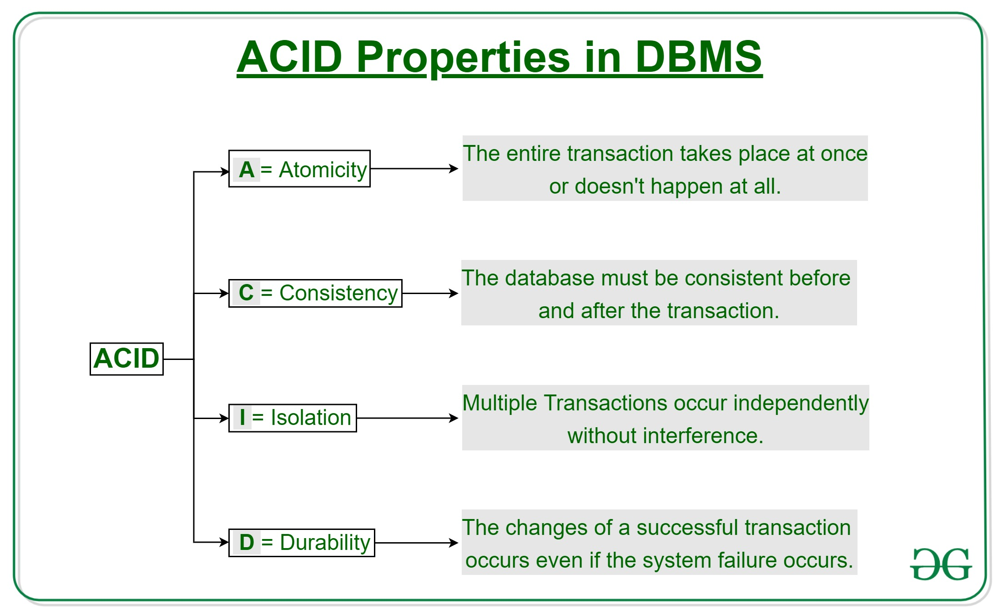

Slide 5
CONCURRENCY CONTROL
Concurrency Control in Database Management System is a procedure of managing simultaneous operations without conflicting with each other
Concurrency Control Protocols
Lock-Based Protocols
Two Phase Locking Protocol
Timestamp-Based Protocols
Validation-Based Protocols

Slide 6
1.LOCK-BASED PROTOCOLS
Lock Based Protocols in DBMS is a mechanism in which a transaction cannot Read or Write the data until it acquires an appropriate lock.
Lock based protocols help to eliminate the concurrency problem in DBMS for simultaneous transactions by locking or isolating a particular transaction to a single user.
All lock requests are made to the concurrency-control manager. Transactions proceed only once the lock request is granted.

Slide 7
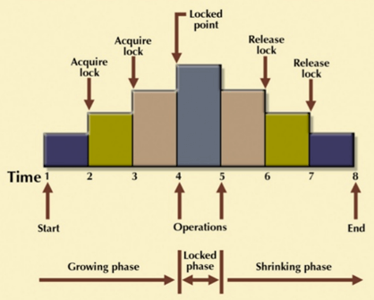
TWO PHASE LOCKING PROTOCOL (2 PL Protocol)
It is a method of concurrency control in DBMS that ensures serializability by applying a lock to the transaction data which blocks other transactions to access the same data simultaneously
Growing Phase: In this phase transaction may obtain locks but may not release any locks.
Shrinking Phase: In this phase, a transaction may release locks but not obtain any new lock

Slide 8
TIMESTAMP-BASED PROTOCOLS
It is an algorithm which uses the System Time or Logical Counter as a timestamp to serialize the execution of concurrent transactions.
It ensures that every conflicting read and write operations are executed in a timestamp order.
The older transaction is always given priority in this method.
It uses system time to determine the time stamp of the transaction.
This is the most commonly used concurrency protocol.

Slide 9
VALIDATION BASED PROTOCOL
It is also called Optimistic Concurrency Control Technique.
It is called optimistic because of the assumption it makes, i.e. very less interference occurs, therefore, there is no need for checking while the transaction is executed.
Until the transaction end is reached updates in the transaction are not applied directly to the database. All updates are applied to local copies of data items kept for the transaction. At the end of transaction execution, while execution of the transaction, a validation phase checks whether any of transaction updates violate serializability. If there is no violation of serializability the transaction is committed and the database is updated

Slide 10
Transaction Model
Transactions access data using two operations:
• read(X), which transfers the data item X from the database to a variable, also called X, in a buffer in main memory belonging to the transaction that executed the read operation.
• write(X), which transfers the value in the variable X in the main-memory buffer of the transaction that executed the write to the data item X in the database.

Slide 11
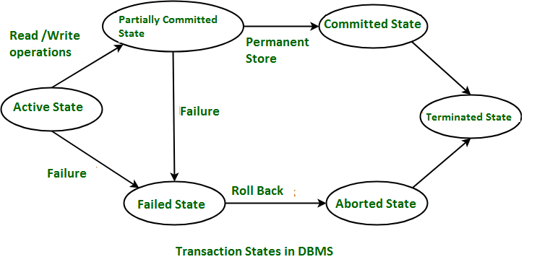
Transaction States
Active State:When the instructions of the transaction are running then the transaction is in active state. If all the ‘read and write’ operations are performed without any error then it goes to the “partially committed state”; if any instruction fails, it goes to the “failed state”.
Partially Committed:After completion of all the read and write operation the changes are made in main memory or local buffer. If the the changes are made permanent on the Data Base then the state will change to “committed state” and in case of failure it will go to the “failed state”.
Failed State:When any instruction of the transaction fails, it goes to the “failed state”

Slide 12

Aborted State :After having any type of failure the transaction goes from “failed state” to “aborted state”
Committed State:It is the state when the changes are made permanent on the Data Base and the transaction is complete and therefore terminated in the “terminated state”.
Terminated State :the transaction comes from the “committed state” goes to this state, then the system is consistent and ready for new transaction and the old transaction is terminated.

Slide 13
System Log
Log is a sequence of records, which maintains the records of actions performed by a transaction.
It is important that the logs are written prior to the actual modification and stored on a stable storage media, which is failsafe.
Log-based recovery works as follows −
The log file is kept on a stable storage media.
When a transaction enters the system and starts execution, it writes a log about it.
<Tn, Start>
When the transaction modifies an item X, it write logs as <Tn, X, V1, V2>.It reads Tn has changed the value of X, from V1 to V2.
When the transaction finishes, it logs <Tn, commit>

Slide 14
THANK YOU

Slide 15
dbms
Module 5 part 2

Slide 16
index
Schedules
Conflict equivalence
Recoverable and cascade-less schedules
Deferred database modification
check-pointing

Slide 17
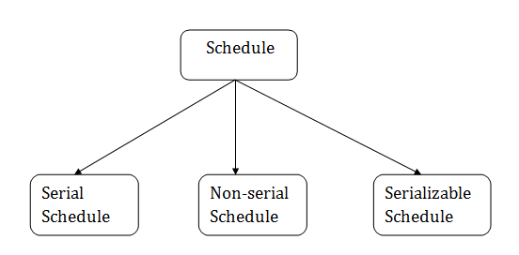
schedule
A series of operation from one transaction to another transaction is known as schedule.
It is used to preserve the order of the operation in each of the individual transaction.

Slide 18
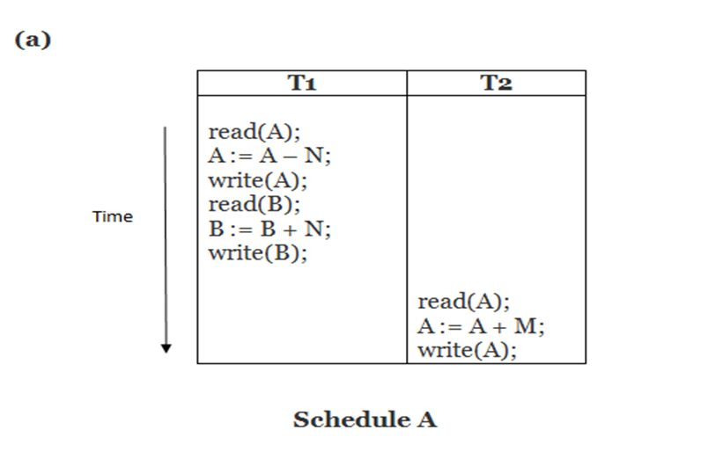
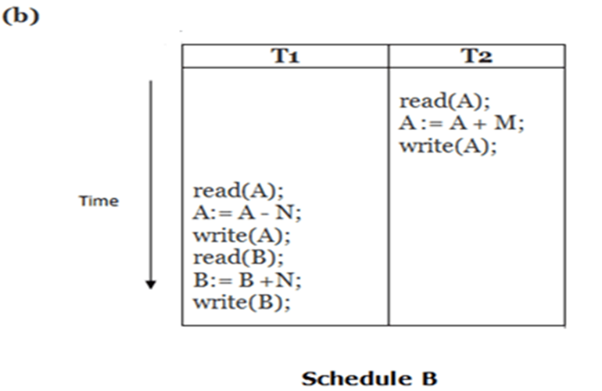
SERIAL SCHEDULE
The serial schedule is a type of schedule where one transaction is executed completely before starting another transaction.
In the serial schedule, when the first transaction completes its cycle, then the next transaction is executed.

Slide 19
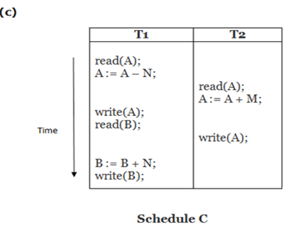
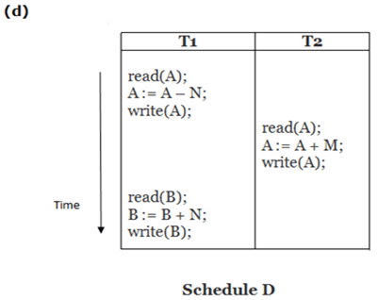
Non-Serial Schedules
If interleaving of operations is allowed, then there will be non-serial schedule.
It contains many possible orders in which the system can execute the individual operations of the transactions.

Slide 20
Serializable schedule
The serializability of schedules is used to find non-serial schedules that allow the transaction to execute concurrently without interfering with one another.
It identifies which schedules are correct when executions of the transaction have interleaving of their operations.
A non-serial schedule will be serializable if its result is equal to the result of its transactions executed serially.
SERIALIZABILITY is a concept that helps us to check which schedules are serializable.

Slide 21
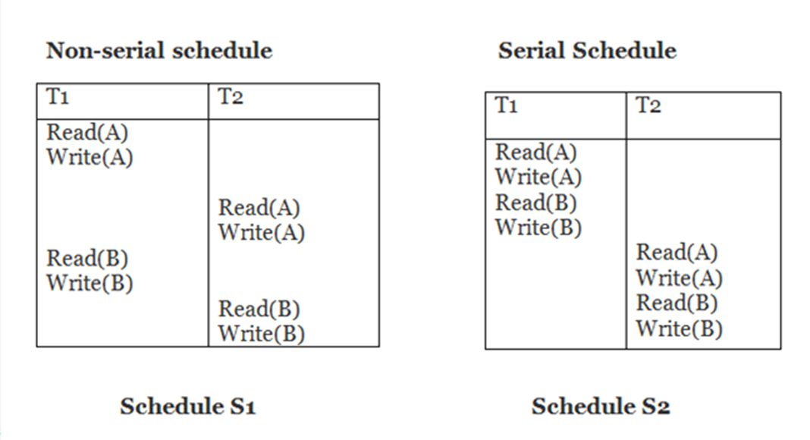
Conflict equivalence
Two schedules are said to be conflict equivalent if and only if:
They contain the same set of the transaction.
If each pair of conflict operations are ordered in the same way.

Slide 22
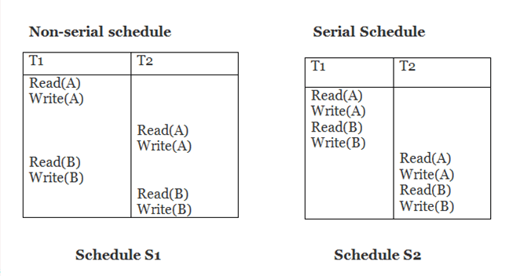
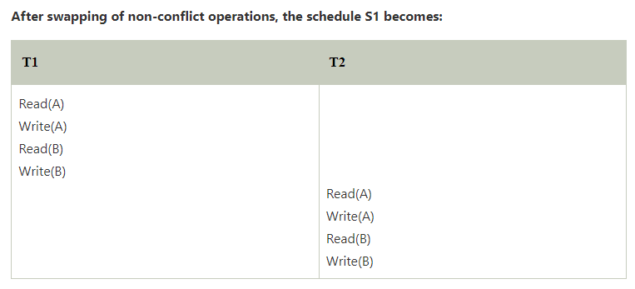

Slide 23
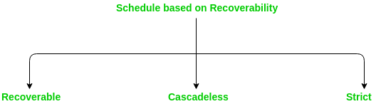

Slide 24
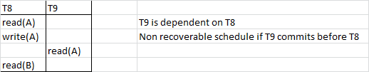
Recoverable Schedule
A recoverable schedule is one where, for each pair of Transaction T_{i} and T_{j} such that T_{j} reads data item previously written by T_{i} the commit operation ofT_{i} appears before the commit operation T_{j} .

Slide 25
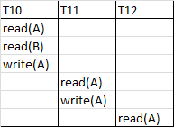
cascade-less schedules
Transaction T10 writes a value of A that is read by Transaction T11. Transaction T11 writes a value of A that is read by Transaction T12. Suppose at this point T10 fails. T10 must be rolled back, since T11 is dependent on T10, T11 must be rolled back, T12 is dependent on T11, T12 must be rolled back.
This phenomenon, in which a single transaction failure leads to a series of transaction rollbacks is called Cascading rollback.

Slide 26
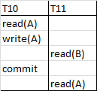
Restrict the schedules to those where cascading rollbacks cannot occur, Such schedules are called Cascadeless Schedules.
A cascadeless schedule is one where for each pair of transaction T_{i} and T_{j} such that T_{j} reads data item, previously written by T_{i} the commit operation of T_{i} appears before the read operation of T_{j}
Every Cascadeless schedule is also recoverable schedule.

Slide 27
Deferred database modification
The deferred modification technique occurs if the transaction does not modify the database until it has committed.
Ie, the changes are not applied immediately to the database.
In this method, all the logs are created and stored in the stable storage, and the database is updated when a transaction commits.
If database modifications occur while the transaction is still active, the transaction is said to use the immediate-modification technique.

Slide 28
check-pointing
The methodology utilized for removing all previous transaction logs and storing them in permanent storage is called a Checkpoint.
A checkpoint is used for recovery if there is an unexpected shutdown in the database.
Checkpoints work on some intervals and write all dirty pages (modified pages) from logs relay to data file from i.e from a buffer to physical disk. It is also known as the hardening of dirty pages
It speeds up data recovery process.

Slide 29
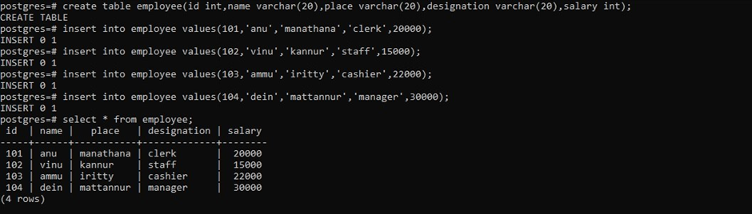
Create table employee (id,name , place,designation,salary)

Slide 30
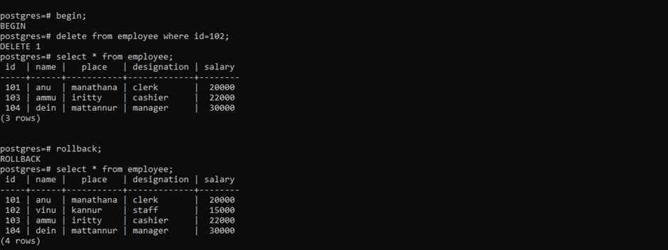
Begin transaction by deleting the details of employ with id 102 and later rollback the changes

Slide 31
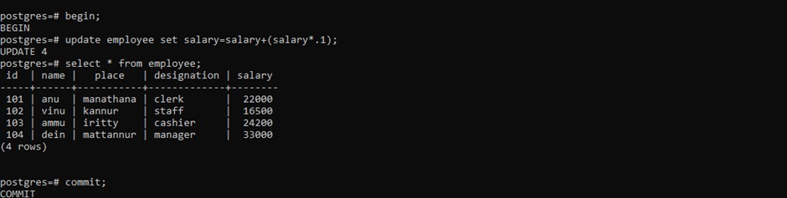
Begin transaction by updating salary(increment by 10%) and commit changes being made

Slide 32
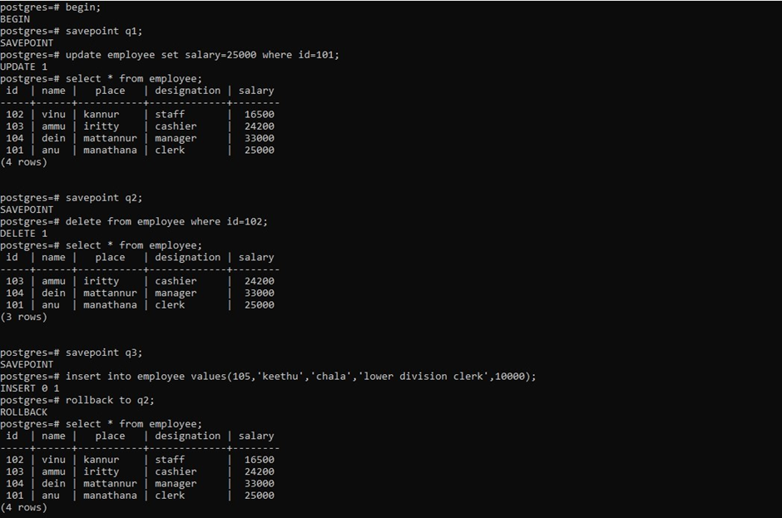
use save point in the transaction

Slide 33
THANK YOU

Slide 34
dbms
Module 5 part 3

Slide 35
index
NoSQL Databases
Key-value DB (examples from: Redis)
Document DB (examples from: MongoDB)
Column - Family DB (examples from: Cassandra)
Graph DB (examples from : ArangoDB)

Slide 36
NoSQL
NoSQL ( "not only SQL") databases are non-tabular databases and store data differently than relational tables.
NoSQL databases come in a variety of types based on their data model. The main types are document, key-value, wide-column, and graph.
They provide flexible schemas and scale easily with large amounts of data and high user loads.

Slide 37
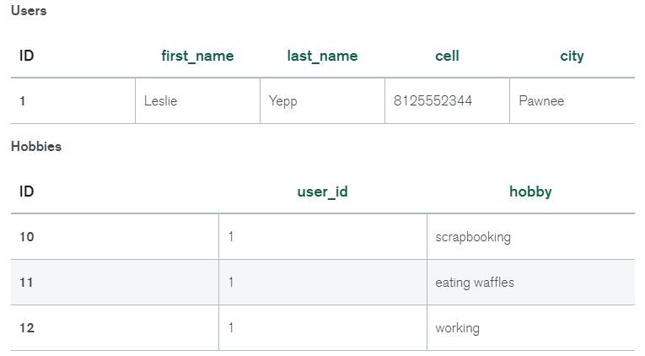
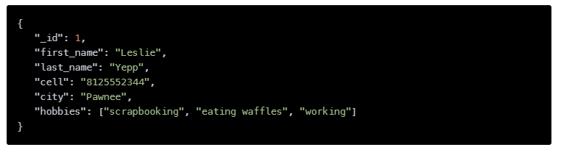
The data model we design for a NoSQL database will depend on the type of NoSQL database we choose.

Slide 38
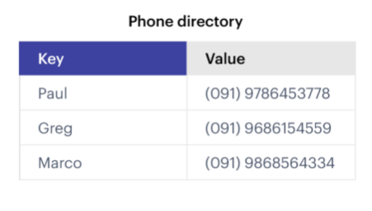
Key-value db
A key-value database (or key-value store) uses a simple key-value method to store data.
These databases contain a simple string (the key) that is always unique and an arbitrary large data field (the value).
They are easy to design and implement.
An Example of Key-value database

Slide 39
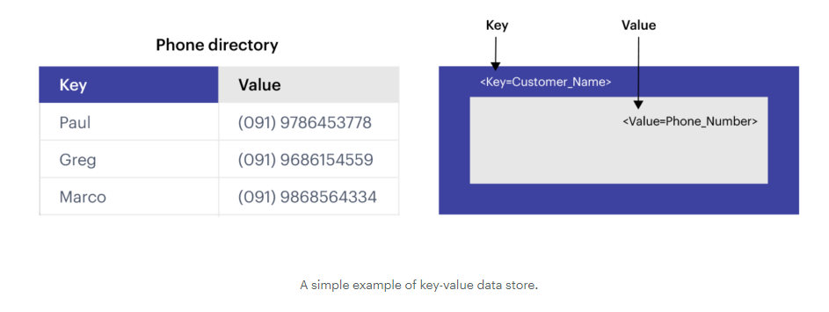

Slide 40
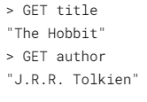
REDIS EXAMPLE
For the vast majority of data storage with Redis, data will be stored in a simple key/value pair. This is best shown through the redis-cli (command line interface) using GET and SET commands.
EG: we may want to store some information about books, such as the title and author of a few of our favorites.
> SET title "The Hobbit"
OK
>SET author "J.R.R. Tolkien"
OK

Slide 41
DOCUMENT DB
Built around JSON-like documents, document databases are both natural and flexible for developers to work with.
They promise higher developer productivity, and faster evolution with application needs.
As a class of non-relational, sometimes called NoSQL database, the document data model has become the most popular alternative to tabular, relational databases.

Slide 42
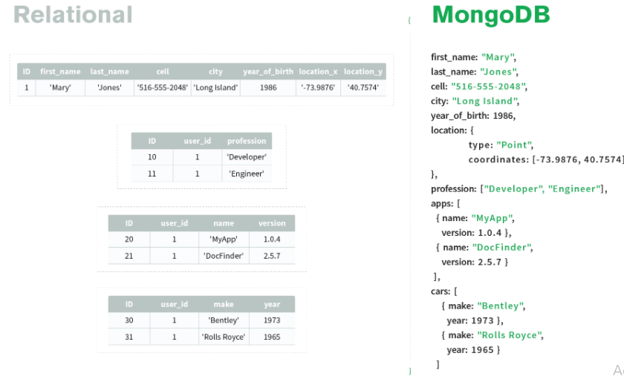
MONGODB EXAMPLE

Slide 43
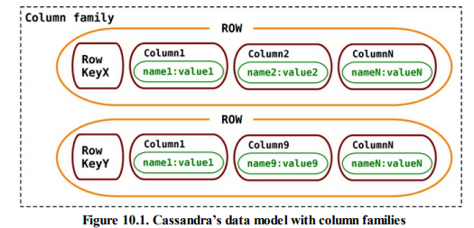
Column - Family DB
Column-family databases store data in column families as rows that have many columns associated with a row key
Example:
RDBMS: Table having the columns ID , Name , Age, Gender, City.
NoSQL: column family will be " ID , NAME , Age" , " Gender,City".

Slide 44
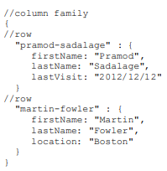
Cassandra EXAMPLE

Slide 45
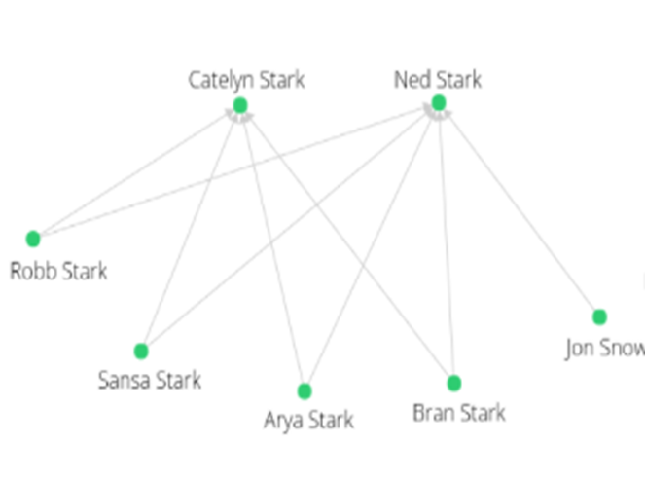
GRAPH DB
Graph databases store schema-free objects (vertices or nodes) where arbitrary data can be stored (properties) and relations between the objects (edges).
Edges typically have a direction going from one object to another or multiple objects.
Vertices and edges form a network of data points which is called a “graph”.

Slide 46

ArangoDB EXAMPLE
LET data = [
{
"parent": { "name": "Ned", "surname": "Stark" },
"child": { "name": "Robb", "surname": "Stark" }
}, {
"parent": { "name": "Ned", "surname": "Stark" },
"child": { "name": "Sansa", "surname": "Stark" }
}, {
"parent": { "name": "Ned", "surname": "Stark" },
"child": { "name": "Arya", "surname": "Stark" }
}, {
"parent": { "name": "Ned", "surname": "Stark" },
"child": { "name": "Bran", "surname": "Stark" }
}………………………..
]

Slide 47
THANK YOU

